Slide 1
Chapter 10
Biopsychology of Emotions, Stress and Health

Slide 2
What is emotion?
A feeling that differs from an individual's normal state
3 central features:
Change in physiological arousal
Affective component
Motivation to act or behave

Slide 3
Early research
Darwin’s The Expression of Emotions in Man and Animals was the first major investigation into biological bases of emotion
Emotions evolved to indicate what an animal would do next in a given situation
These behaviours were advantageous to the animal

Slide 4
James-Lange theory
Suggests that emotion-inducing stimuli are received and interpreted by the brain
This triggers visceral changes (changes in the abdomen or thorax) that subsequently trigger the experience of emotion

Slide 5
Problems with James-Lange theory
Cannon (1927)
Emotion can occur in the absence of visceral response
Emotional responses often occur too quickly to be a result of visceral changes
Visceral modifications cause kinds of emotional situations and slight physiological difference between emotional states cannot be sensed

Slide 6
Cannon-Bard theory
Canon-Bard theory is an alternative theory based on the idea that emotional stimuli evoke visceral and emotional responses that are independent of one another

Slide 7
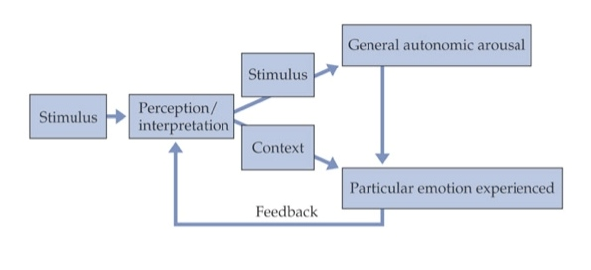
Schachter-Singer theory
When aroused or tense, and cause is unknown, we attribute arousal to environmental conditions
Schachter-Singer study (1962)
Participants injected with adrenaline
Uninformed or misinformed of drug effects
Attributed arousal to environment

Slide 8
Sham rage
Pretend, or sham, rage is a quasi-emotional state
It is produced in animals by removing the cerebral cortex (decortication)
Bard first recognized this occurrence when he observed that cats that no longer had a cortex would still have an aggressive reaction to stimuli (Bard, 1929)
Removal of the cortex down to the hypothalamus still triggered sham rage in the cats
Hypothalamus must play a role in expressing aggressive responses

Slide 9
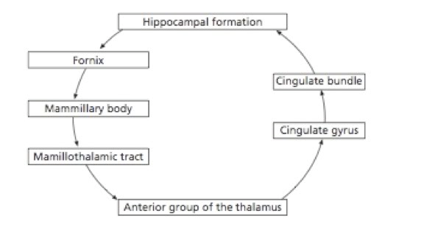
Anatomy of emotions: the limbic system – Papez Circuit
Limbic system is
Involved in the cortical regulation of emotion
Learning and memory, emotion and social behaviour
Long circuitous pathway in the forebrain of mammals
First attempt to suggest an anatomical substrate of emotional experience

Slide 10
Hippocampus
Role in memory formation and the process of long-term potentiation
The hippocampus and the amygdala are connected
Hippocampal complex influences the amygdala reactions whenever emotional activities occur
Emotional meaning

Slide 11
Amygdala
The structure forms connections with the hippocampus, the septal nuclei and the prefrontal area as well as the medial dorsal nucleus of the thalamus
Plays a role in forming and storing memories connected with emotional occurrences
Fear conditioning
Central nuclei

Slide 12
Thalamus
Lesion or stimulation of the medial dorsal and anterior nuclei of the thalamus have been associated to altered emotional behaviour

Slide 13
Hypothalamus
Lesions of the hypothalamic nuclei disrupt both sleep and wakefulness along with motivational behaviours, body temperature, sexual behaviours, fight reaction, appetite and thirst (Flament-Durand, 1980)
Lateral sections appears to be associated with pleasure and anger, while the median section is believed to be associated with aversion and displeasure

Slide 14
Cingulate gyrus
Located in the medial area of the brain in the middle of the cingulate sulcus and the corpus callosum
Anterior cingulate gyrus appears to be involved in unconscious priming with pleasurable episodic memories and is involved in the emotional reaction to pain as well as the control of aggressive behaviour

Slide 15
Ventral tegmental area
Located in the mesencephalic part of the brain stem
This area is associated with the experience of happy feelings and intense romantic love (Xu et al., 2011)

Slide 16
Septum
Located in a position that is anterior to the thalamus
This area has been connected to various types of pleasant feelings, mainly those that have to do with sexual experiences (Chozick, 1985)

Slide 17
Prefrontal area
Even though it is not really part of the traditional limbic circuit, it is made up of links to the thalamus, amygdala and other sub-cortical structures
Disruption of dorsomedial prefrontal cortical-amygdala connectivity has recently been implicated in postpartum or postnatal depression (Moses-Kolko et al., 2010)

Slide 18
A definition of aggression
Behaviour motivated by the intent to harm another being
Many diverse behaviours can be considered aggressive

Slide 19
Insular
This area is also responsible for processing tastes and may be pivotal to the experience of feeling disgust (Phillips et al., 1997)

Slide 20
Cerebral hemispheres and emotion
Behavioural approach system (BAS) – left hemisphere is believed to regulate appetitive motives, in which the goal is to move towards something desired
Behavioural avoidance (or inhibition) system (BIS) – right frontal and temporal regions are said to regulate aversive motives, in which the goal is to move away from something unpleasant
An imbalance in BIS and BAS levels is reportedly related to a variety of forms of psychopathology (Scholten, van Honk, Aleman, & Kahn, 2006)

Slide 21
Emotions and facial expressions
Paul Ekman and others have been first in undertaking the study of feelings and their correlation to how the face looks (Ekman, 1992)
In cross-cultural research on Papua New Guinea's Fore tribesmen, Ekman and Friesman formulated a menu of basic emotions (Ekman & Friesen, 1986)
Anger, disgust, fear, happiness, sadness and surprise.
The Facial Action Coding System (FACS) is a research tool that was devised to essentially measure facial expressions by defining the muscular movement underlying brief alterations in facial expression
All facial expressions can be decomposed into their constituent action units (AU). AUs appear in combinations of expressions (Ekman & Friesen, 1977)

Slide 22
Facial feedback hypothesis
The idea of facial feedback is that any facial movement or expressions you make can have a direct effect on your emotional experience (Buck, 1980)
Results reveal that facial feedback modulates neural processing of emotional stimuli – Botox

Slide 23
Duchenne smile
It appears that there are two ways to differentiate genuine facial expressions from expressions that are fake (Ekman, Davidson, & Friesen, 1990)
Genuine smiles (Duchenne smiles) involve contraction of both the zygomaticus major and the orbicularis oculi, whereas false smiles only involve the zygomaticus major

Slide 24
Attack behaviours
Attack or aggressive behaviours refers to any actions that aim to cause harm or inflict pain
There are two general categories of aggression: hostile, affective or retaliatory aggression; and instrumental, predatory or goal-oriented aggression (McElliskem, 2004)
Animals use aggression to assist them in obtaining and maintaining territory, as well as in obtaining other needs essential for survival, such as food, water and mating possibilities

Slide 25
Hormones & neurotramsmitters
Testosterone
Converted to 5a-DHT which acts on androgen receptors
Testosterone positively correlated with aggression
Glucocorticoids
Large a group of fat-soluble hormones that connect to the glucocorticoid receptor and seem to play a role in hostile behaviour and are normally released during aggressive interaction between animals
Dehydroepiandrosterone (DHEA)
DHEA is an androgen and can swiftly be metabolized into strong androgens and estrogens
Serotonin
A lack of serotonin has consistently demonstrated a relationship with impulsive aggressive behaviour over several different research paradigms

Slide 26
Stress
Stressor: any event that either strains or overwhelms our ability to adjust to our environment
Can be physiological or psychological
Physiological consequences of stressor influenced by psychological processes

Slide 27
Our biological reaction to stressors
Selye (1956)… general adaptation syndrome (GAS)
3 stages
Stage 1 – alarm reaction
Sympathetic nervous system arousal
Body prepares for ‘fight or flight’
Reaction lasts minutes to hours
When stressor ends, parasympathetic nervous system takes over

Slide 28
Our biological reaction to stressors (cont.)
Stage 2 – resistance
Release of adrenocorticotrophic-stimulating hormone (ACTH)
Triggers the release of glucocorticoid hormone leading to
Conversion of non-sugars to sugars
Enhancement of glycogen storage
Increased effectiveness of adrenaline & noradrenaline
Systems not involved in stress resistance are inhibited
Suppression of inflammatory system
Reduction in ability to fight illness

Slide 29
Our biological reaction to stressors (cont.)
Stage 3 – exhaustion
This stage of the general adaptation syndrome is the most hazardous to your health
Depletion of physiological resources
Failure of electrolyte balance
Exhaustion of lipid reserves
Inability to produce glucorticoids
Damage to vital organs
When no resources remain, death ensues

Slide 30
Acute stress: the sympathomedullary pathway
Fight or flight pathway – associated with acute stress
Hypothalamus stimulates autonomic centres in the brain
Signals are sent via nerve pathways to the adrenal medulla
Adrenal medulla releases adrenaline and noradrenaline into the bloodstream
These increase heart rate and blood pressure which supply oxygen to the muscles
Liberate energy reserves for physical activity
Afterwards PNS restores body to resting state

Slide 31
Chronic stress: the pituitary-adrenal system
Associated with chronic stress
Hypothalamus stimulates the pituitary gland
Pituitary gland releases ACTH – travels via the bloodstream to the adrenal cortex
The adrenal cortex releases corticosteroids (cortisol)
These release stored energy reserves
Suppression of the immune system

Slide 32
The immune system - psychoneuroimmunology
B-cells
B-cells grow to maturity mainly in the bone marrow
Release Y-shaped proteins that link specifically to certain
Memory B-cells develop out of activated B-cells that are specific to the antigen encountered during the primary immune response
T-cells
Have special receptor on their cell surface referred to as T-cell receptors (TCR)
Natural killer T-cells play a big part in the body's the rejection of tumour cells and cells that are infected by viruses
Do not just attack one specific intruder, they attack all of them
Other types of T-cell assist other T-cells or B-cells to grow in number
Phagocytes
Phagocytes or white blood cells guard the body by ‘eating’ (phagocytosing) damaging non-natural particles like bacteria or dead or dying cells
Cytokines
To counter infection, leukocyte and other cells produce small proteins known as cytokines
These fight infection and communicate with the brain to let you know that you are ill

Slide 33
Post traumatic stress disorder (PTSD)
Is a severe anxiety disorder in which a person develops symptoms subsequent to experiencing a horrifying or life threatening event
Symptoms include recurring, distressing flashbacks and bad dreams about the event
A heightened response to external stimuli (Murray, 1992)
Symptoms have to be present for more than 30 days for a PTSD diagnosis, with significant damage in social and other important areas of functioning
Individuals with PTSD secrete low amounts of cortisol and high amounts of noradrenaline, suggesting that low cortisol levels may put someone at higher risk of developing PTSD (Meewisse et al., 2007)
It appears that hyperarousal of the amygdala is involved in PTSD (Koenigs et al., 2008)

Slide 34
Theories of emotion

Slide 35
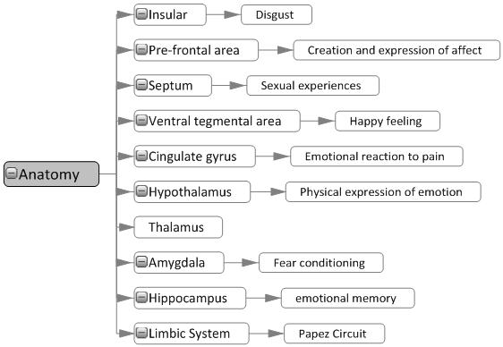
Anatomy

Slide 36
Stress

Slide 37
Stress

Slide 38
Readings
Barnes, J. (2011). Essential Biological Psychology (Chapter 10). London: Sage.
The Essentials
Oatley, D., Keltner, D., & Jenkins, J. (2006). Understanding Emotions (2nd edn). Chichester: Wiley-Blackwell.
Next Steps
Glaser, R., & Kiecolt-Glaser, J. (2005). How stress damages immune system and health. Discovery Medicine, 5(26), 165-169.
Delving Deeper
Phelps, E.A. (2004). Human emotion and memory: interactions of the amygdala and hippocampal complex. Current Opinion in Neurobiology, 14(2), 198-202.

